Slide 1
Information Visualization Session 4: Tell Your Story
Matthias Shapiro
@politicalmath
matthias.shapiro@outlook.com

Slide 2
Agenda
Interactive visualizations
Choosing a visual for promotion
Sharing best practice
Defending your visualization

Slide 3
You will need: Excel Photoshop (or equivalent)

Slide 4
visualization design

Slide 5
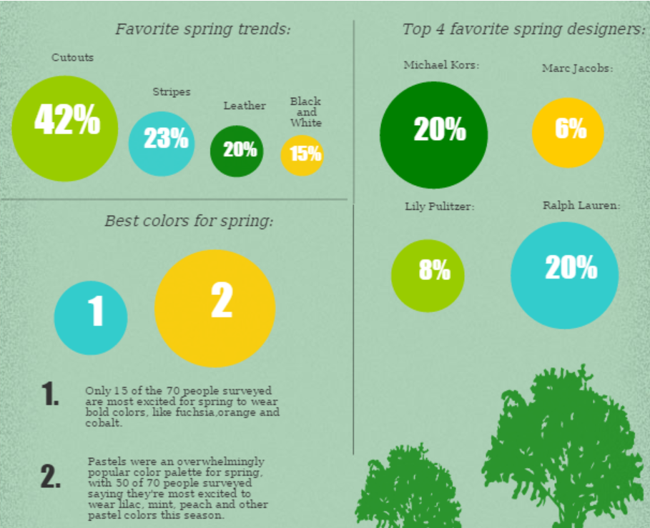

Color Design
Complement
Contrast

Slide 6
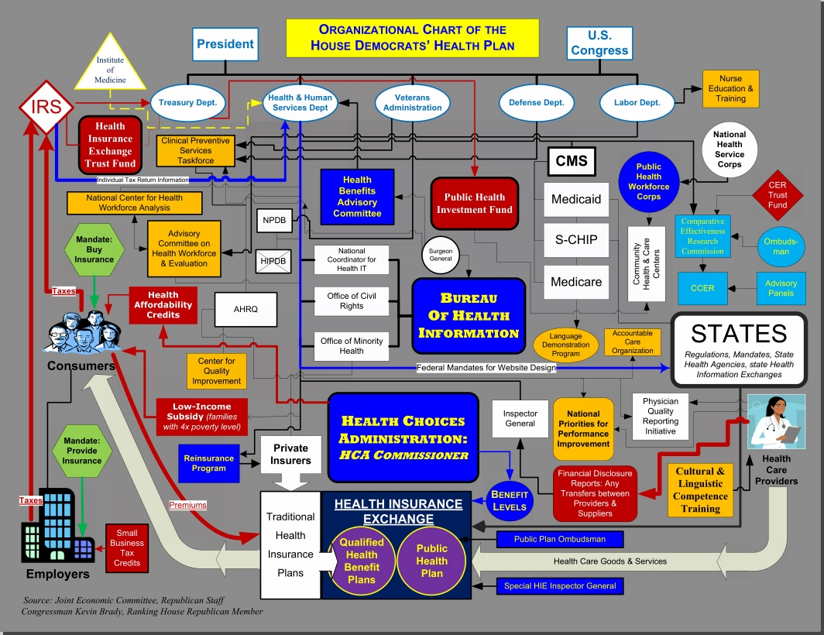
Color Design
Intentionally awful

Slide 7
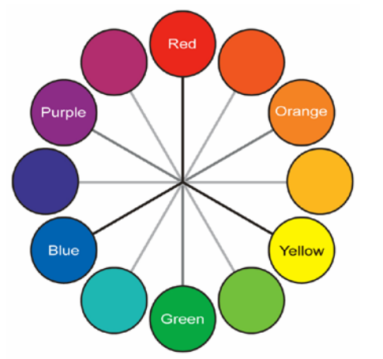
Color Design
Using a hue wheel

Slide 8
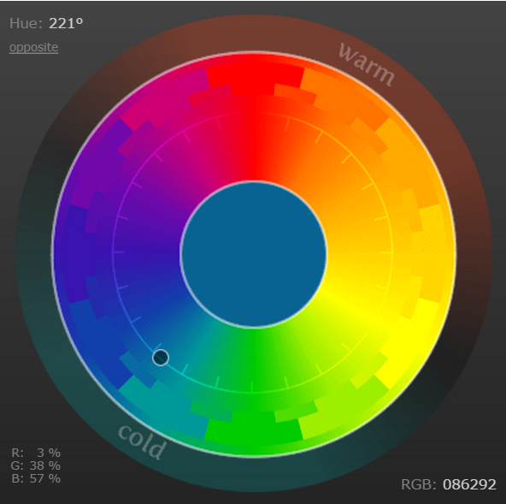
Color Design
Online color tools
http://colorschemedesigner.com/csd-3.5/

Slide 9
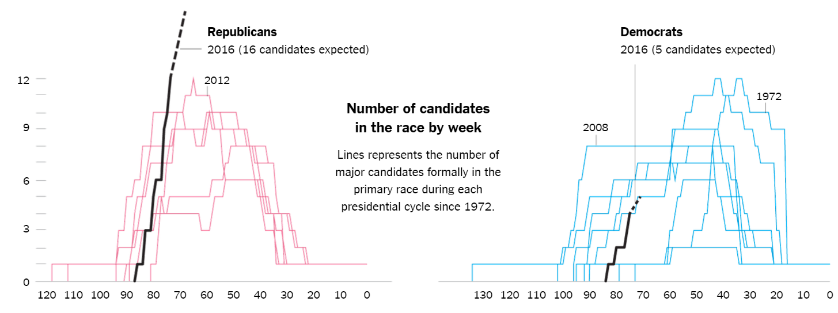
Text
Minimize textual information

Slide 10
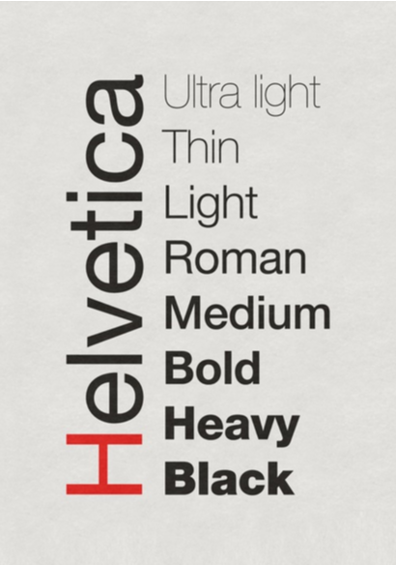
Text - fonts
Keep to one font family
Helvetica (on Mac)
Segoe (on Windows)
Handwriting fonts
http://www.yourfonts.com/

Slide 11
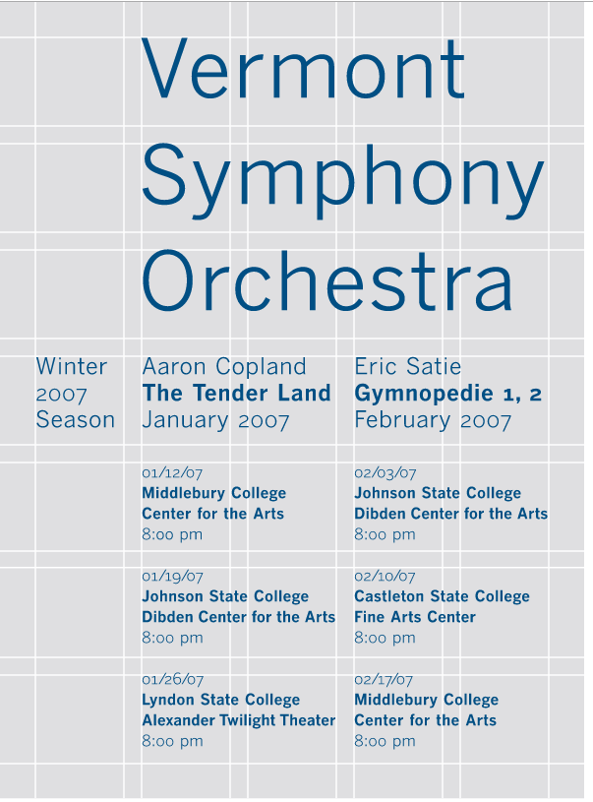
layout
Alignment
grid systems (swiss)

Slide 12
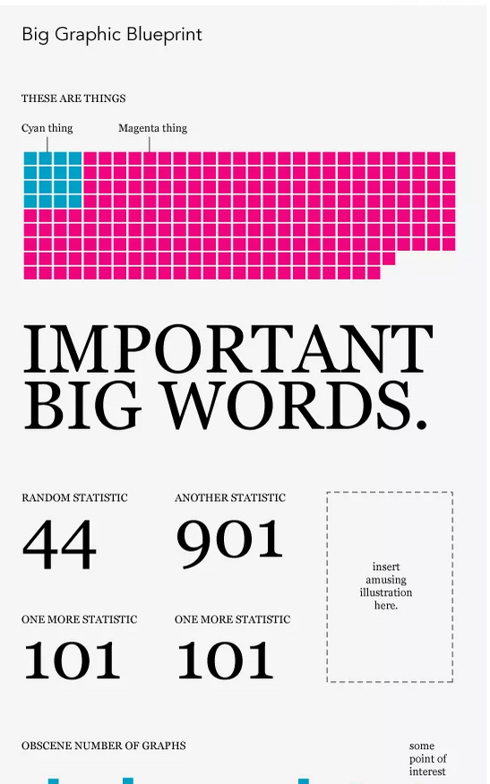
layout
Alignment
grid systems (swiss)
Templates
the big data graphic blueprint
http://flowingdata.com/2010/02/15/data-underload-9-big-graphic-blueprint/

Slide 13
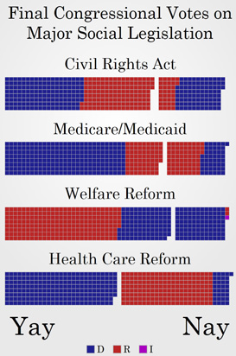
layout
unit segmentation
visual detail lends visual interest to the scene
http://politicalmathblog.com/?p=424

Slide 14
interactive visualizations

Slide 15
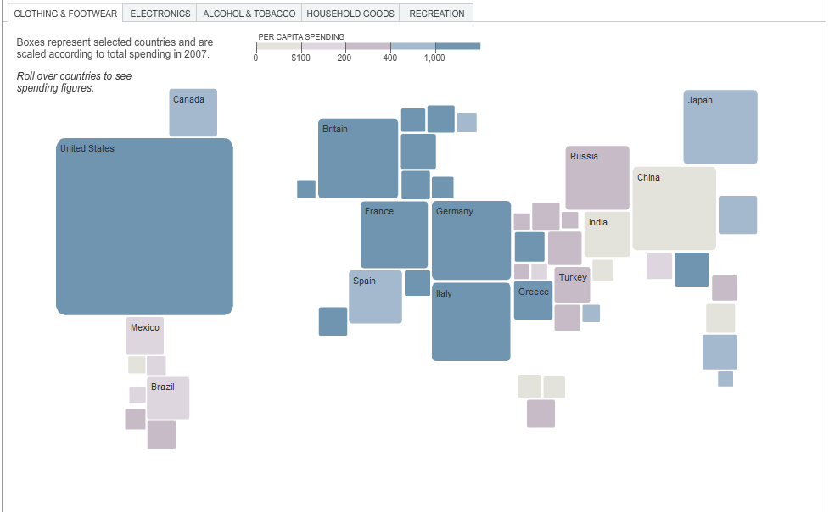
Charts vs. Visualizations
Notes:
Here we have a New York Times visualization of spending on clothing and footwear across the world. The boxes are sized in order to represent the raw amount of spending that that country does and then the boxes are shaded to indicate how much spending that is per person (per capita). Now the creator could have just put this information in a list, but decided instead to place the boxes in a rough geographic relationships. This simple decision allows the user to quickly scan and figure out which country is which.
You can see the United States taking up the bulk of spending in the western hemisphere, we can see richer countries in Europe pull their share of data and we see poorer countries in South America and Africa register only the smallest bits of spending.
You’re immediately asking important questions about this data… “Where does my country stand on this map? How did we do against the guys next door?” This familiarity has created interest and that interest has inspired curiosity and (hopefully) that curiosity will inspire a stake in the data.

Slide 16
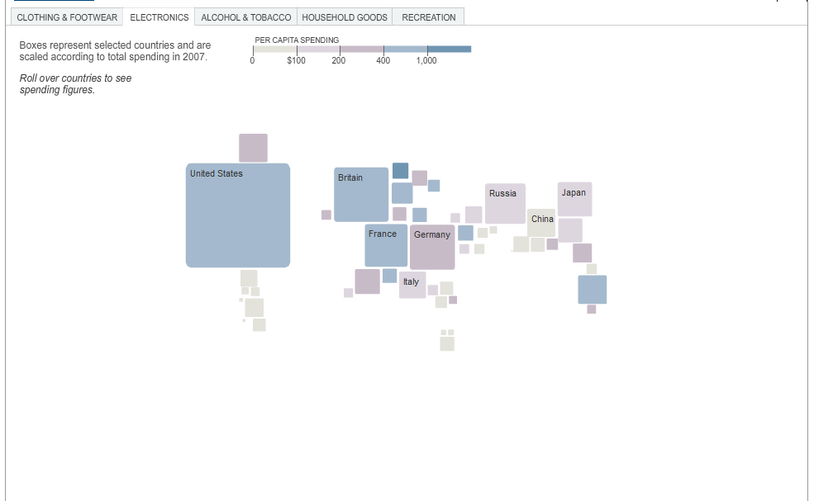
Charts vs. Visualizations
Notes:
But if we look at this data on the website, we would find that it is interactive. Once we understand how this visualization works, the parameters and context, we can carry that understanding over to look at how much each country spends on electronics.

Slide 17
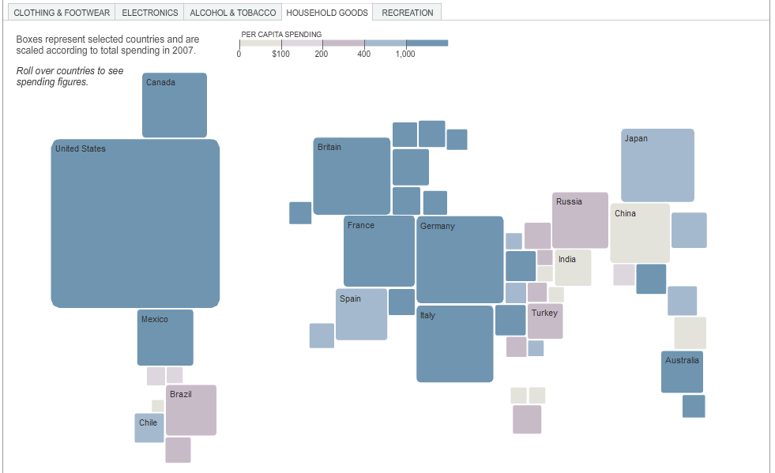
Charts vs. Visualizations
Notes:
Or on house hold goods

Slide 18
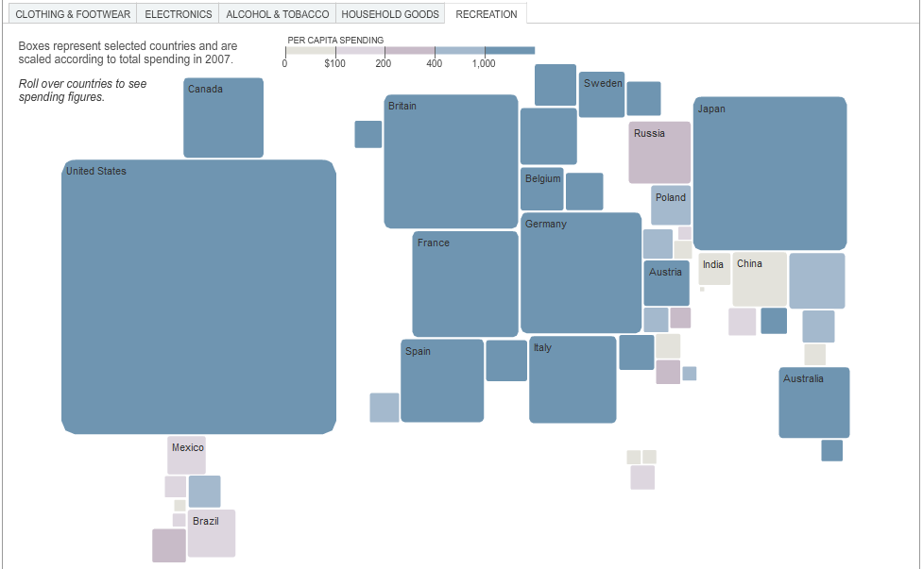
Charts vs. Visualizations
Notes:
Or on recreation

Slide 19
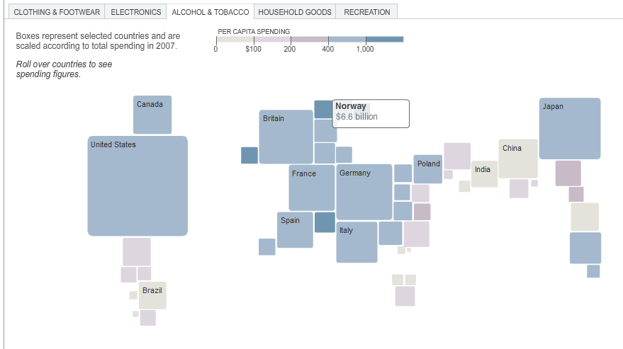
Charts vs. Visualizations
Notes:
Or on alcohol and tobacco. In addition to the initial interaction of switching between the different types of spending, we can hover over any particular item to have a more specific and granular view of the data. Using this interaction, we can see more detail on alcohol and tobacco spending in Norway and immediately know that it is a fantastic place to spend a weekend… probably in the summer.

Slide 20
choosing a visual for promotion

Slide 21
Sharing through social media

Slide 22
Stills vs. Interactive Viz

Slide 23
Sharing Interactive Viz

Slide 24
Visualizations on Mobile

Slide 25
defending your visualization

Slide 26
Defending – Show Your Work
Make Excel files available for download
Import files to Google Docs

Slide 27
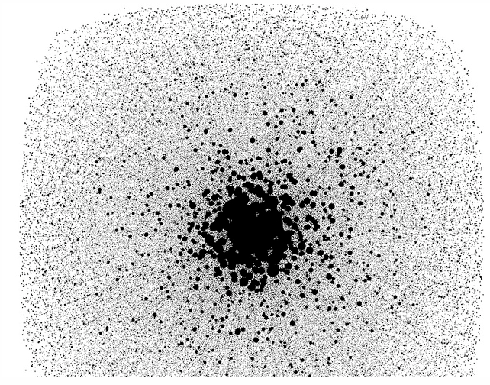
Defending – Ready To Be Wrong
limited when data set becomes too large
(1000’s of data points)

Slide 28
Visual Metric - Networks
limited when data set becomes too large
(1000’s of data points)

Slide 29
defending your visualization

Slide 30
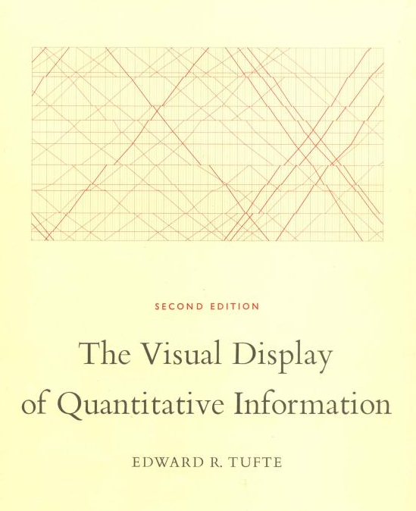

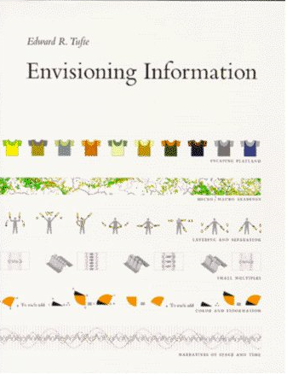
Edward Tufte
visualization book club
Information Visualization god
Notes:
Finally, if you’d like to know more about visualization, here are a couple of recommendations. First in line is Edward Tufte. Tufte is considered the leader in information visualization literature. If you’re more interested in discussion over hundreds of examples and a more academic approach to the topic, this is the way to go.

Slide 31
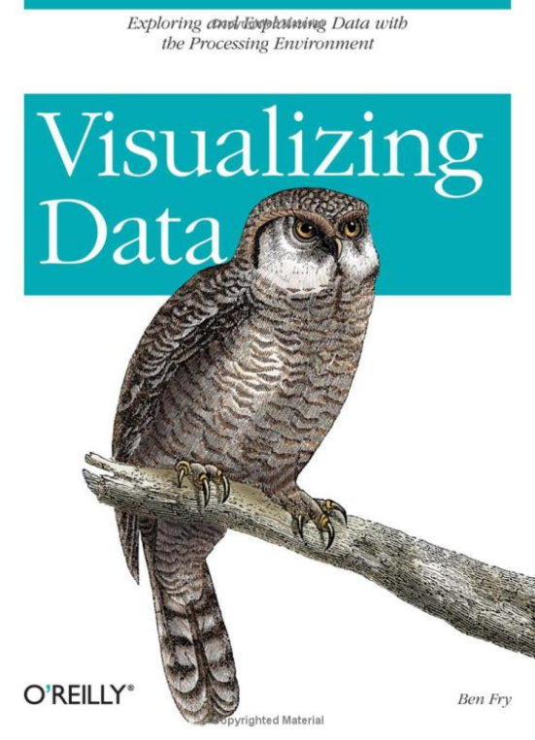
Ben Fry
visualization book club
“Visualizing Data”
Processing
http://processing.org
http://benfry.com/
Notes:
If you’re looking for something a little bit more hands-on and you don’t mind doing some programing, Ben Fry wrote a book called “Visualizing Data” in which he walks through several code-complete visualizations using a number of different data sets and techniques.

Slide 32
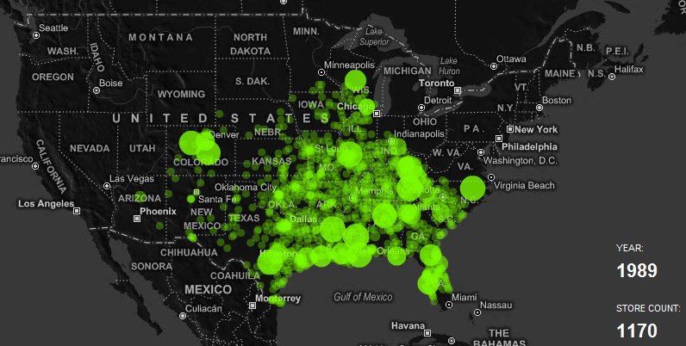
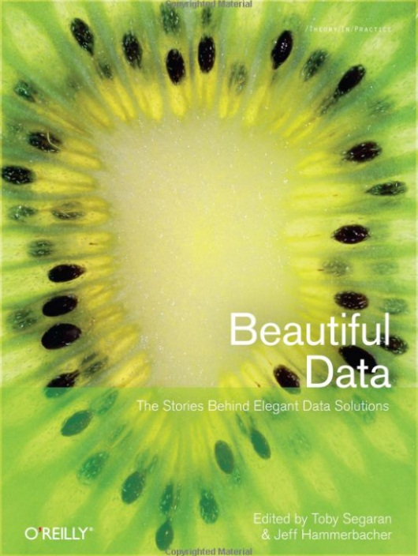
Nathan Yau
visualization book club
Contributing Author for Beautiful Data
http://flowingdata.com/
Notes:
Finally, if you just have a passing interest in data visualization, but you want to see more cool stuff, check out Nathan Yau’s blog “Flowing Data”. Yau is a PhD student (soon to be a PhD) who is deep into information visualization and posts visualizations that pop up on the web. It’s an excellent blend of good examples, bad examples and academic offerings.

Slide 33
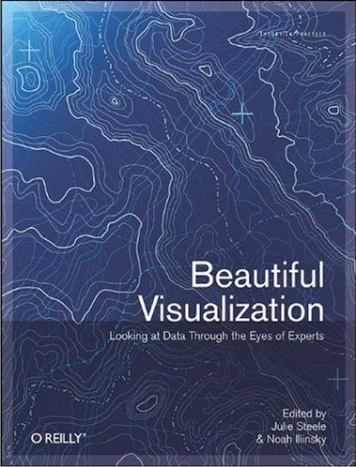
Beautiful Visualization
visualization book club
Free Chapter
“Once Upon a Stacked Time Series”
Notes:
Finally, The O’Reilly book “Beautiful Visualization” is a compilation of visualization topics and techniques from over a dozen leaders in the field.

